Slide 1



Slide 2
Table of contents
Asset Class Performance to 31 October 2025 SA Equity Performance to 31 October 2025 Commodities Performance to 31 October 2025 Global Market Performance to 31 October 2025 SA Markets Resources vs Financials vs Industrials Earnings per share and price-earnings ratios South African Volatility Index (SAVI) Exchange Rate overview (CPI - Best Fit) Interest rates and bond yields Bond Yields Equity Yields vs Interest Rates MSCI vs Earnings MSCI EM vs Earnings Global Markets Overview MSCI Relative Price-Earnings Ratios (Trailing) MSCI and SWIX Relative Price-Earnings Ratios (Trailing) Global market volatility Global Bonds SA Rand against the US Dollar, Pound & Euro (12 months)
SA Rand against the US Dollar, Pound & Euro (5 years) Exchange Rates (USDZAR) Exchange Rates (GBPZAR) Exchange Rates (EURZAR) SA equities vs. global developed & emerging markets (12 months) SA equities vs. global developed & emerging markets (5 years) US Institute for Supply Management Index SA Purchasing Managers Index Gold Price (USD) Brent Crude Price per Barrel (USD) Platinum Price (USD) Conclusion Disclaimer

Slide 3
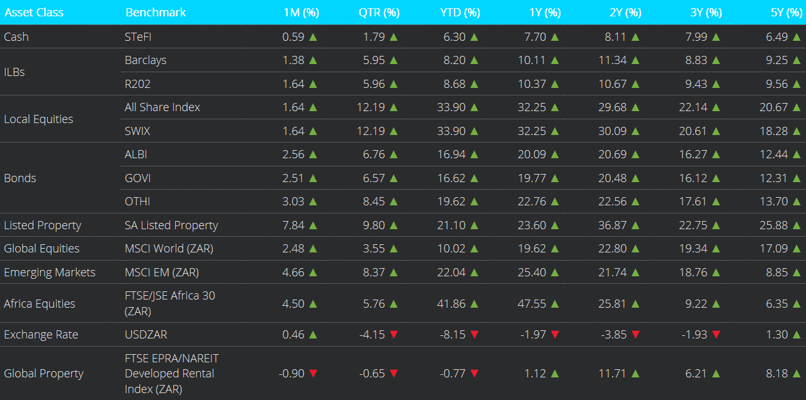
Asset Class Performance to 31 October 2025
Notes:
Global equity markets delivered strong returns in October, reversing typical seasonal weakness, supported by a combination of monetary easing, robust corporate earnings, and continued enthusiasm around artificial intelligence (AI). The MSCI World Index rose 2.5% (in ZAR), while the MSCI Emerging Markets Index gained 4.7% (in ZAR) for the month of October.
On a total return basis, SA inflation-linked bonds and nominal bonds were up in October.
The ALBI strengthened by +2.6%, while inflation-linked bonds as measured by the Barclays ILB index increased by +1.4%.
South African listed property rose by +7.8%.
The USD/ZAR exchange rate ended the month at R17.33.

Slide 4
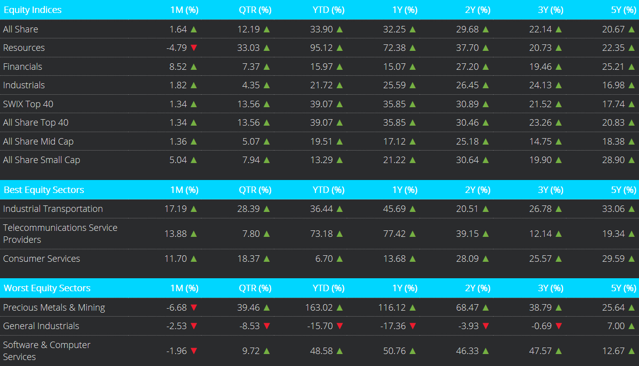
SA Equity Performance to 31 October 2025
Notes:
From a market’s perspective, South African equities as measured by the FTSE/JSE All Share Index posted a gain of 1.6% in October.
Within equities; Resources declined by -4.8%, Industrials gained +1.8%, whilst Financials gained +8.5%.
On a market capitalisation basis, the All Share Top 40 increased by +1.3%, followed by the All Share Mid Cap Index with +1.4%, whilst the All Share Small Cap gained +5%.

Slide 5
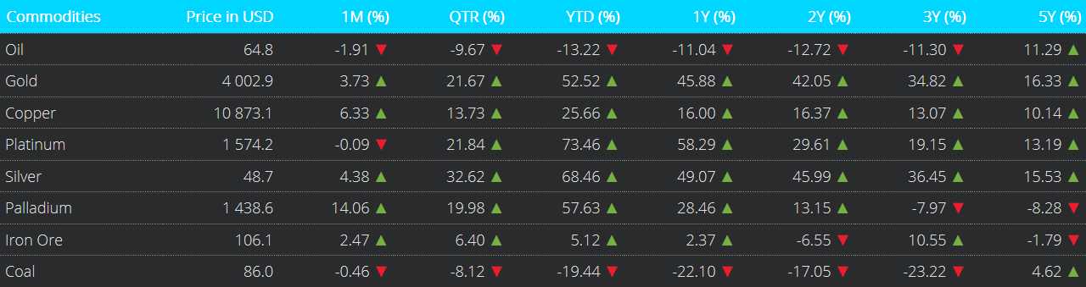
Commodities Performance to 31 October 2025
Notes:
Precious metals had a mixed month of performance.
October saw Palladium rising by +14.1% and Platinum registering a marginal decline of -0.1%.
Gold gained +3.7%, Silver gained +4.4% and Copper gained +6.3%.
The oil price decreased by -1.9%.
Lastly, the Coal price declined by -0.5%.

Slide 6
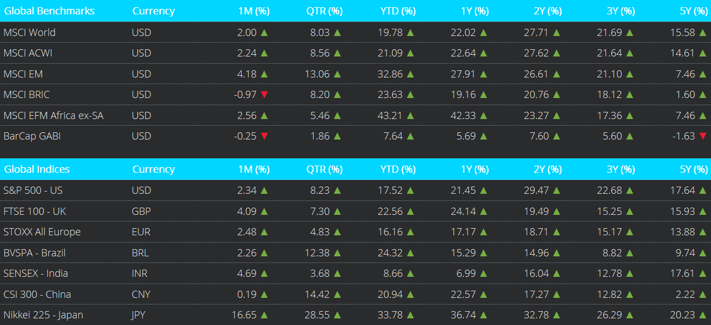
Global Market Performance to 31 October 2025
Notes:
In October, the MSCI World and MSCI All Country World Index (ACWI) rose by +2.00% and +2.24% respectively, while the MSCI Emerging Markets Index gained +4.18% in USD terms.
The S&P 500 increased by +2.34%.
UK equities, FTSE 100, closed higher by +4.09%.
The broader European index, STOXX All Europe, was up by +2.48%.
The Nikkei 225 gained +16.65%.
Brazil's BVSPA (Ibovespa) increased by +2.26%. Meanwhile, China's CSI 300 index rose by +0.19%, as well as India's SENSEX index by +4.69%.

Slide 7
SA Markets
Notes:
The FTSE/JSE All Share Index closed +1.64% higher in October. On a 12‑month basis, it has increased by +32.25%.

Slide 8
Resources vs Financials vs Industrials
Notes:
This chart shows the performance of three key South African sector indices: the Resources, Financials, and Industrials.
For the month of October, Financials increased by +8.52%, Industrials registered a gain of +1.82%, whilst Resources declined by -4.79%.
Across these sectors, Resources was the best-performing sector on a 12-month basis, returning +72.38%. This was followed by Industrials, which gained +25.59%, and Financials, which was up +15.07%.

Slide 9
Earnings per share and price-earnings ratios
Notes:
This chart compares the cumulative return of the All-Share Index, as shown by the yellow line, to its cumulative earnings per share, as shown by the red line.
Earnings per share increased and remained above the All-Share index as at the end of October. The All-Share Index continues to appear attractive on a price-to-earnings valuation basis .

Slide 10
South African Volatility Index (SAVI)
Notes:
The South African Volatility Index (SAVI) is a key financial metric used to gauge market sentiment and expected risk in the South African equity markets.
The SAVI saw an increase in the index from 14.82 in September to 15.04 in October. This likely reflects that investors are pricing in higher levels of uncertainty regarding the future path of equity prices.

Slide 11
Exchange Rate overview (CPI - Best Fit)
Notes:
This chart compares the effective Rand-Dollar exchange rate as shown by the yellow line to the Purchasing Power Parity (PPP) Rand-Dollar exchange rate as shown by the red line, which is calculated with Consumer Price Inflation, on a best-fit basis.
Using this lens through which to value the Rand against the US Dollar, the local currency remains heavily undervalued.
The PPP-implied exchange rate is approximately R11.80 per USD while the actual exchange as at end October was R17.33 per USD

Slide 12
Interest rates and bond yields
Notes:
In October, the repo rate remained at 7.0%.

Slide 13
Bond Yields
Notes:
The yield on the nominal 2-year R186 bond was 7.38% at the end of October, with longer-dated yields, such as the R2048, expiring in 23 years, posting 9.97% for the month.

Slide 14
Equity Yields vs Interest Rates
Notes:
This chart depicts equity earnings yields, shown by the yellow line, relative to bond yields as shown by the red line. ​
​
In October, the R186 bond yield decreased, and equity yields decreased. The R186 bond continues to offer higher yields than the FTSE JSE All-Share Index, reflecting better relative value. However, the gap between bond and equity yields has expanded, making the advantage more pronounced than in prior years.

Slide 15
MSCI vs Earnings
Notes:
This chart compares the MSCI World Index, Developed Markets, price growth with the earnings growth of the underlying companies within the index over time.
The price index continues to rise as US tech companies lead the way, with an upward jump movement over August. Developed markets were also supported by rate cuts from the US Federal Reserve in late October.
In contrast, earnings growth has been relatively flat for much of the past 12–18 months, only beginning to show a modest recovery from late 2024 onward. While prices have outpaced earnings, the recent uptick suggests improving fundamentals.

Slide 16
MSCI EM vs Earnings
Notes:
This chart compares the MSCI Emerging Markets Index price growth with the growth of its earnings per share over time.
The price growth continued in October, complemented by a slight decrease in earnings per share.

Slide 17
Global Markets Overview
Notes:
This chart depicts the long-term performance of various MSCI indices.
The long-term trend remains in place: Developed and Emerging Markets outperform Frontier and Emerging Frontier African markets.
For the approximate 16-year period under consideration, the Frontier Markets and the Africa ex. SA indices have been flat-to-negative, though in recent months, Frontier Markets returns have turned positive.

Slide 18
MSCI Relative Price-Earnings Ratios (Trailing)
Notes:
In this chart, we depict the price-earnings or PE ratios for various MSCI Indices using the past 12 months' earnings, i.e., trailing earnings.
In October, MSCI EFM Africa ex-ZA P/E ratio decreased, while the MSCI EM, MSCI World , and MSCI FM P/E ratios increased.

Slide 19
MSCI and SWIX Relative Price-Earnings Ratios (Trailing)
Notes:
Here we depict the trailing price-earnings or PE ratios for the various MSCI Indices shown in the previous slide and now include the SWIX index as shown by the blue line.
The SWIX P/E ratio has generally tracked close to the MSCI Frontier Markets Index over time, though it currently sits slightly lower.
Compared to the MSCI Emerging Markets Index, the SWIX trades at a noticeable discount, highlighting relatively cheaper valuations in the South African equity market.
Meanwhile, the MSCI World Index remains elevated versus all others, reflecting the premium pricing in developed markets.

Slide 20
Global market volatility
Notes:
The VIX, a real-time index that tracks market sentiment (fear and greed) relating to the S&P 500.
A low VIX typically implies less market uncertainty, and improved investor confidence in the short-term.
A rising and/or high VIX reading implies the opposite.
The VIX increased over the month, from 16.28 in September to 17.44 in October.

Slide 21
Global Bonds
Notes:
The Bloomberg Barclays Global Aggregate Bond Index (BarCap GABI) decreased by -0.25% in USD terms in October.
On a 12-month view, it has increased by +5.69%.

Slide 22
SA Rand against the US Dollar, Pound & Euro (12 months)
Notes:
This chart depicts the performance of the South African Rand against the US Dollar, Great British Pound and the Euro over the 12 months to end of October 2025.
During October, the Rand strengthened against all three major currencies, the Dollar, Pound, and Euro. However, on a 12-month basis, it remains weaker relative to the Pound and Euro, while showing a broadly firmer trend against the US Dollar.

Slide 23
SA Rand against the US Dollar, Pound & Euro (5 years)
Notes:
This chart shows the 5-year performance of the local currency against the US Dollar, Pound and Euro.
Over this period, the Rand has depreciated against the Pound and Euro, reflecting a generally weaker trend in the local currency over time. While the Rand appreciated against the dollar, reflecting a generally stronger trend in the local currency over time.

Slide 24
Exchange Rates (USDZAR)
Notes:
This chart depicts the long-term performance of the Rand/US Dollar exchange rate.
The local currency depreciated by 0.5% against the US Dollar in October; it is 1.97% stronger against the US Dollar relative to 12 months ago.

Slide 25
Exchange Rates (GBPZAR)
Notes:
The long-term performance of the Rand/British Pound exchange rate.
The local currency appreciated by 1.3% against the British Pound in October; it is 0.29% weaker against the British Pound relative to 12 months ago

Slide 26
Exchange Rates (EURZAR)
Notes:
Long‑Term EUR/ZAR Performance
The South African Rand appreciated by 1.56% against the Euro in October. Over the last 12 months, the Rand is 4.2% weaker versus the Euro.

Slide 27
SA equities vs. global developed & emerging markets (12 months)
Notes:
This chart depicts the 12-month performance of the All-Share Index, MSCI World and the MSCI Emerging Markets Indices in Rand terms.
The All-Share Index boasts the highest gain relative to the MSCI World and Emerging markets over a 12-month period.

Slide 28
SA equities vs. global developed & emerging markets (5 years)
Notes:
This chart shows the performance of the indices shown in the previous slide over the five years ending October 2025.
In this time frame, the MSCI EM Index is the relative laggard.
The All-Share Index continues to lead in Rand terms.

Slide 29
US Institute for Supply Management Index
Notes:
The US ISM Manufacturing PMI decreased from 49.1 in September to 48.7 in October.
A reading of this index of 50 or above implies economic expansion, while a reading of below 50 implies economic contraction
This means that the manufacturing segment of the US economy remains in an economic contraction phase.

Slide 30
SA Purchasing Managers Index
Notes:
The seasonally adjusted Absa Purchasing Managers’ Index (PMI) fell to 49.2 in October 2025 from 52.2 in September, the highest since October last year, pointing to a renewed expansion in factory activity. A reading of this index of 50 or above implies economic expansion, while a reading of below 50 implies economic contraction.
This indicates a worsening manufacturing activity in October.

Slide 31
Gold Price (USD)
Notes:
The price of Gold increased in October, closing the month at $4 002.92 per ounce, an incline of +3.73% over the month.

Slide 32
Brent Crude Price per Barrel (USD)
Notes:
The price of Brent Crude Oil decreased by -1.91% in October, closing the month at $64.77 per barrel.

Slide 33
Platinum Price (USD)
Notes:
The price of Platinum was broadly unchanged in October, closing the month at $1 574.23 per ounce, a marginal decline of -0.09%.

Slide 34
Conclusion

Slide 35
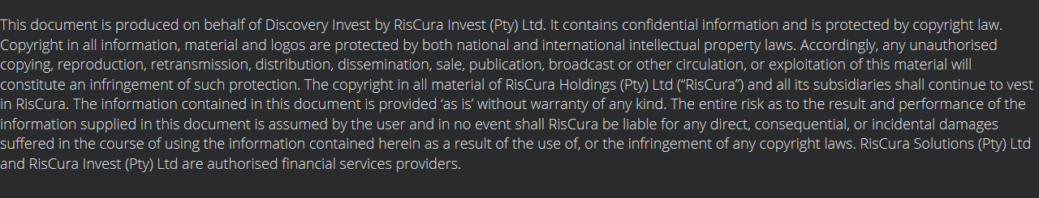
Disclaimer

